Slide 1
Day 16
Linux Device Driver Training
SECURE CODING IN C
Presented by,
Ganavi M
Ganavigowda512@gmail.com

Slide 2
SECURE CODING IN C
Input Validation:
Validate all input from external sources, such as user input, file input, and network input.
Ensure that input data is within expected bounds and does not contain malicious content.
Use functions like fgets instead of gets to prevent buffer overflow vulnerabilities.
Memory Management:
Use safe memory management practices to prevent memory leaks, buffer overflows, and dangling pointers.
Always free dynamically allocated memory when it is no longer needed to prevent memory leaks.
Avoid accessing or dereferencing pointers after they have been freed to prevent undefined behavior.
Avoid Unsafe Functions:
Avoid using unsafe functions like gets, strcpy, and sprintf that do not perform bounds checking.
Use safer alternatives like fgets, strncpy, and snprintf that provide bounds checking to prevent buffer overflow vulnerabilities.
Integer Security:
Be mindful of integer overflow and underflow vulnerabilities, especially when performing arithmetic operations.
Use integer types with appropriate size and range for the intended purpose.
Consider using compiler flags or library functions to detect and prevent integer overflow at runtime.

Slide 3
Secure Coding Standards:
Follow established secure coding standards such as CERT C, MISRA C, and OWASP Secure Coding Practices.
These standards provide guidelines and recommendations for writing secure and reliable C code, covering topics like input validation, memory management, and secure communication.
Input Sanitization:
Sanitize input data to remove or escape potentially dangerous characters and prevent injection attacks.
Use input validation and filtering techniques to reject or sanitize input that could be used to exploit vulnerabilities, such as SQL injection and cross-site scripting (XSS).
Secure File Operations:
Be cautious when performing file operations to prevent path traversal, file disclosure, and arbitrary file execution vulnerabilities.
Use absolute paths, validate file paths, and restrict file permissions to prevent unauthorized access and manipulation of files.
Secure Communication:
Use secure communication protocols like HTTPS, SSH, and TLS to encrypt data transmitted over networks.
Implement secure authentication and authorization mechanisms to verify the identity and permissions of users and systems

Slide 4
Security Testing:
Conduct thorough security testing, including static analysis, dynamic analysis, and penetration testing.
Use automated testing tools and manual review processes to identify and mitigate security vulnerabilities in your code.
Continuous Monitoring and Maintenance:
Regularly monitor and maintain your codebase to address security vulnerabilities and stay up-to-date with security updates and patches.
Implement a process for handling security incidents and responding to emerging threats in a timely manner.

Slide 5

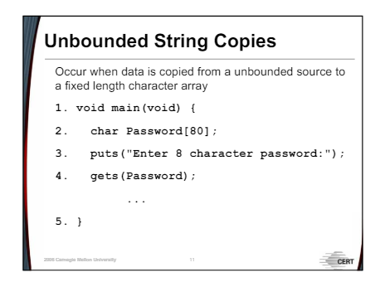
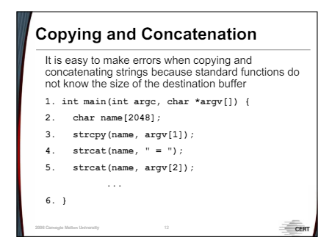

Slide 6
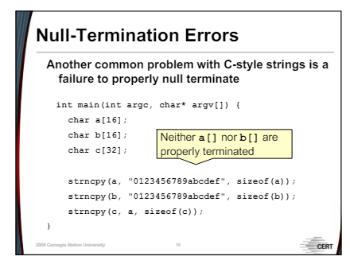
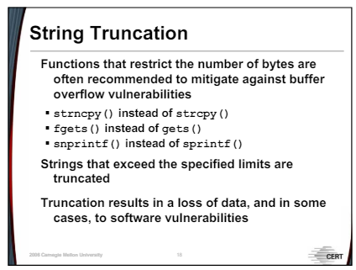

Slide 7
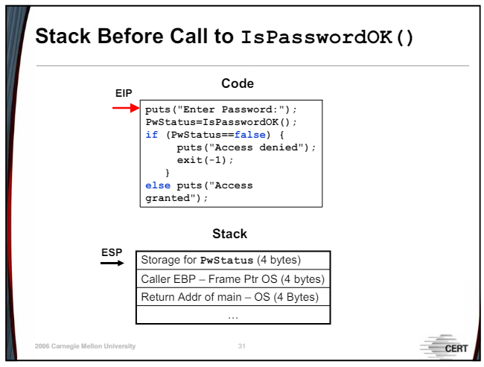
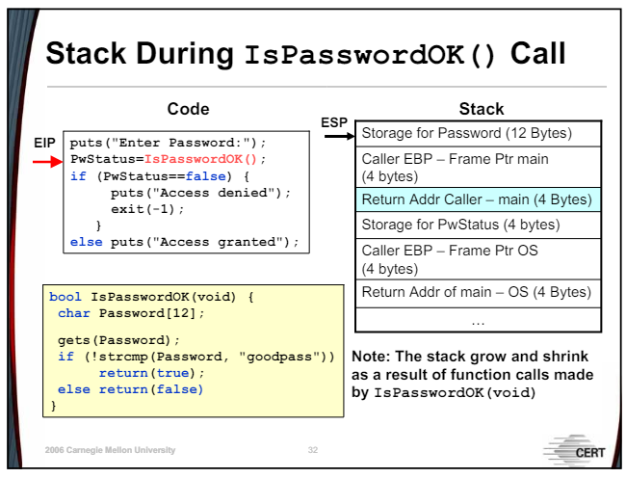

Slide 8
Thank you

